Slide 1
Design and Analysis of Algorithms Getting Started(Ch2)
Software School
ZhangLiyong

Slide 2
About the Course
Design and Analysis
  How can I propose an algorithm for a specific problem?
  Is the algorithm good enough?
Design
Analysis
D
&
C
Greedy
D
P
…
B
a
s
i
c
s
C
a
s
e
s
M
S
Q
S
…
A
S
P
H
u
f
f
m
a
n
…
A
L
S
M
C
M
…
H
S
…

Slide 3
Why study algorithm and performance?
Algorithms help us to understand scalability.
Performance often draws the line between what is feasible and what is impossible.
Algorithmic mathematics provides a language for talking about program behavior.
The lessons of program performance generalize to other computing resource.
Speed is fun.
Notes:
scalability：可量测性

Slide 4
The problem of sorting
Input: sequence <a₁,a₂,…,a_{n}> of n natural numbers
Output: permutation <a’₁,a’₂,…,a’_{n}> such that a’₁≤a’₂≤…≤a’_{n}
Example
--Input: <5,2,4,6,1,3>
--Output: <1,2,3,4,5,6>
Notes:
permutation:：排列

Slide 5
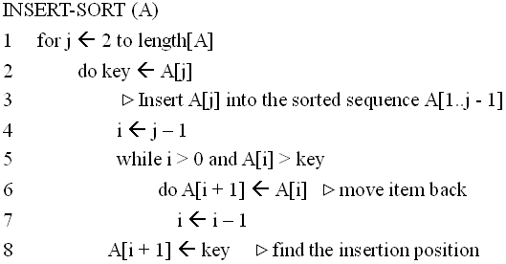
Insertion Sort
1
i
j
n
sorted
key

Slide 6
Insertion Sort
初始
j=2
j=3
1
2
3
4
5
6
1
2
3
4
5
6
1
2
3
4
5
6
-∞
8
5
7
9
6
4
-∞
8
5
7
9
6
4
-∞
5
8
7
9
6
4
j=4
j=5
j=6
1
2
3
4
5
6
1
2
3
4
5
6
1
2
3
4
5
6
-∞
5
7
8
9
6
4
-∞
5
7
8
9
6
4
-∞
5
6
7
8
9
4

Slide 7
Analysis of algorithms
The theoretical study of computer-program performance and resource usage.
what’s more important than performance?
--modularity --user-friendliness
--correctness --programmer time
--maintainability --simplicity
--functionality --extensibility
--robustness --reliability

Slide 8
Proving correctness using loop-invariants
A technique to prove that an algorithm is correct. Identify a loop-invariant.
Initialization: It is true prior to the first iteration of a loop.
Maintenance: If it is true before an iteration of the loop, it remains true before the next iteration.
Termination: when the loop terminates, the invariant gives us a useful property that shows that the algorithm is correct.

Slide 9
Proving correctness using loop-invariants
A loop-invariant for insertion sort:
--At the start of each iteration of the for loop, the subarray A[1..j - 1] consists of the elements originally in A[1..j - 1] but in sorted order.
Initialization j = 2.
Maintenance: A[j - 1], A[j - 2],… are moved one at a time till the proper position for A[j] is found.
Termination: j = n + 1. we have correct output.

Slide 10
Running time
The running time depends on the input: an already sorted sequence is easier to sort.
Parameterize the running time by the size of the input, since short sequences are easier to sort than long ones.
Generally, we seek upper bounds on the running time, because everybody likes a guarantee.

Slide 11
Kinds of analysis
Worst-case: (usually)
--T(n) = maximum time of algorithm on any input of size n.
Average-case: (sometimes)
--T(n) = expected time of algorithm over all inputs of size n.
--Need assumption of statistics distribution of inputs.
Best-case: (bogus)
--Cheat with a slow algorithm that works fast on some input.
Notes:
Bogus：假的, 伪造的

Slide 12
Machine-independent time
What is insertion sort’s worst-case time?
--It depends on the speed of our computer:
>>relative speed (on the same machine)
>>absolute speed (on different machine)
BIG IDEA:
--Ignore machine-dependent constants.
--Look at growth of T(n) as n → ∞
“Asymptotic Analysis”

Slide 13
Θ--notation
Math:
Θ(g(n)) = {f(n): There exist positive constants c₁, c₂, and n₀ > 0 such that 0≤c₁g(n) ≤f(n)≤c₂g(n) for all n≥n₀}
Engineering:
--Drop low-order terms; ignore leading constants.
--Example: 3n³ + 90n² – 5n + 6046 = Θ(n³)

Slide 14
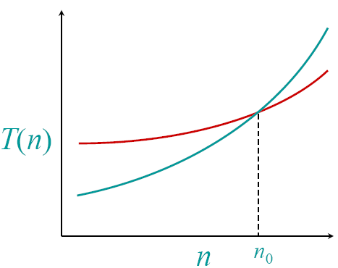
Asymptotic performance
When n gets larger enough, a Θ(n²) algorithm always beats a Θ(n³) algorithm
-- We shouldn’t ignore asymptotically slower algorithms, however.
-- Real-world design situations often call for a careful balancing of engineering objectives.
-- Asymptotic analysis is a useful tool to help to structure our thinking.

Slide 15
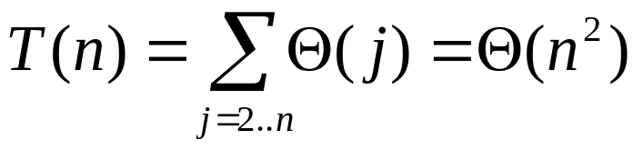
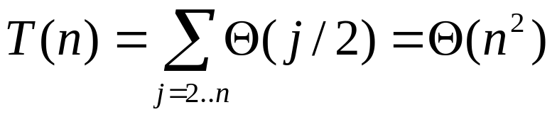
Insertion sort analysis
Worst case: Input reverse sorted
Average case: All permutations equally likely
Is insertion sort a fast sorting algorithm?
--Moderately so, for small n.
--Not at all, for large n.

Slide 16
Analysis algorithms
Analysis an algorithm: predicting the resources, including memory, communication bandwidth, or computer hardware and so on, that the algorithm requires.
But most often we want to measure the computational time of an algorithm.
Before we can analyze an algorithm, we must have a model of the implementation technology that will be used, including a model for the resources of that technology and their costs.

Slide 17
Analysis algorithms
We shall assume a generic one-processor, random-access machine (RAM) model of computation.
-- Instructions are executed one after another, with no concurrent operations.
--Each time, an instruction of a program is executed as an atom operation. An instruction includes arithmetic operations, logical operations, data movement and control operations.
-- Each such instruction takes a constant amount of time.
-- RAM capacity is large enough.
--…
Under RAM model: count fundamental operations

Slide 18
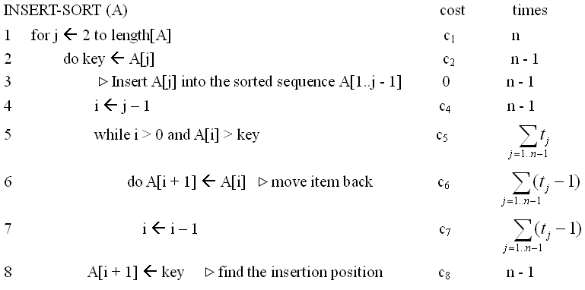


Analysis of insertion sort
cost times
c₁
n
c₂
n-1
0
n-1
c₄
n-1
c₅
c₆
c₇
c₈
n-1
t_{j} : the number of times the while loop test in line 5 is executed for the j value.

Slide 19
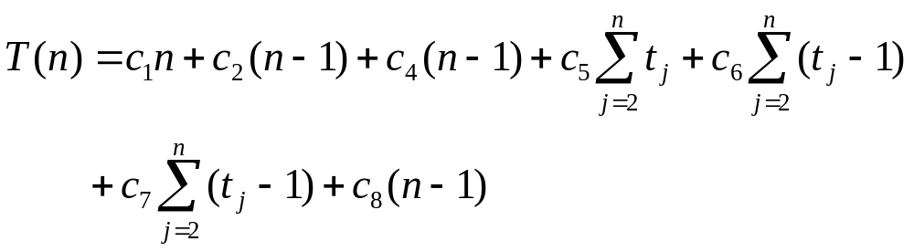
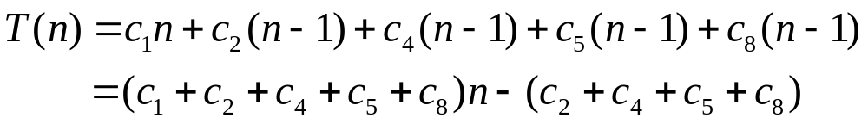
Analysis of insertion sort
To compute T(n), the running time of Insertion-sort, we sum the products of the cost and times columns, obtaining
The best-case if the array is already sorted,
--The running time is a linear function of n.

Slide 20
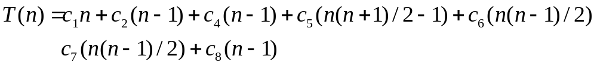
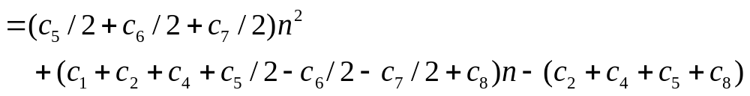
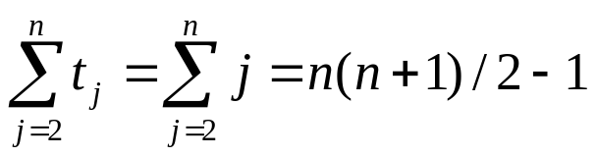
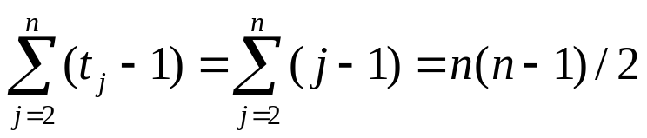
Analysis of insertion sort
The worst-case results if the array is in reverse sorted order- that is, in decreasing order.
-- The running time is a quadratic function of n.

Slide 21
Worst-case and Average-case Analysis
Note:
-- Upper bound on the running time for any input.
-- For some algorithms, worst-case occur fairly often.
>>e.g. Searching in a database for a particular piece of information
--Average case often as bad as worst case (but not always!)

Slide 22
Order of Growth
We will only consider order of growth of running time:
-- We can ignore the lower-order terms, since they are relatively insignificant for very large n.
-- We can also ignore leading term’s constant coefficients, since they are not as important for the rate of growth in computational efficiency for very large n.
--We just said that best case was linear in n and worst/average case quadratic in n.

Slide 23
Designing Algorithms
We discussed insertion sort
--We introduced RAM model of computation
--We analyzed insertion sort in the RAM model
--We discussed how we are normally only interested in growth of running time:
>>Best-case linear in O(n), worst-case quadratic in O(n²)
-- Can we design better than n² sorting algorithms?
-- We will do so using one of the most powerful algorithm design techniques.

Slide 24
Divide - and - Conquer
To solve P:
-- Divide P into smaller problems P₁, P₂, …, P_{k}.
-- Conquer by solving the (smaller) subproblems recursively.
-- Combine the solutions to P₁, P₂, …, P_{k} into the solution for P.

Slide 25
Divide - and - Conquer
Recursive in structure
Problem(size n)
sub
problem 1
sub
problem 2
…
sub
problem k
Combine
sub
problem 11
sub
problem 12
…
sub
problem 1k
sub
problem 21
sub
problem 22
…
sub
problem 1k
…
………………………
………………
sub
problem 1’
sub
problem 2’
sub
problem 3’
………………
directly solvable

Slide 26
Divide - and - Conquer
Problem(size n)
:Divide
:Combine
sub
problem 1
sub
problem 2
…
sub
problem k
:solve recursively
sub
problem 21
sub
problem 22
…
sub
problem 2k
Notes:
分治法在每一层递归上都有三个步骤：
分解：将原问题分解为若干个规模较小，相互独立，与原问题形式相同的子问题；
解决：若子问题规模较小而容易被解决则直接解，否则递归地解各个子问题；
合并：将各个子问题的解合并为原问题的解。

Slide 27
Divide - and - Conquer
Problem(size n)
sub
problem 1
sub
problem 2
…
sub
problem k
:Combine
:Divide
sub
problem 21
sub
problem 22
…
sub
problem 2k
:solve recursively
Notes:
对于上述过程中某个特定子问题的求解也是一个递归的类似的过程。
并不是所有的问题都可以采用分治策略来求解。那分治法的使用条件都有哪些呢？

Slide 28
Simple Review
Insertion Sort Analysis
  Proving correctness using loop-invariants
  RAM model of computation
  We discussed how we are normally only interested in growth of running time:
    Best-case linear in O(n), worst-case quadratic in O(n²)
Divide and Conquer
  General Method
  Merge Sort

Slide 29
Divide - and - Conquer
Problem(size n)
:Divide
:Combine
sub
problem 1
sub
problem 2
…
sub
problem k
:solve recursively
sub
problem 21
sub
problem 22
…
sub
problem 2k
Notes:
分治法在每一层递归上都有三个步骤：
分解：将原问题分解为若干个规模较小，相互独立，与原问题形式相同的子问题；
解决：若子问题规模较小而容易被解决则直接解，否则递归地解各个子问题；
合并：将各个子问题的解合并为原问题的解。

Slide 30
Divide - and - Conquer
Problem(size n)
sub
problem 1
sub
problem 2
…
sub
problem k
:Combine
:Divide
sub
problem 21
sub
problem 22
…
sub
problem 2k
:solve recursively
Notes:
对于上述过程中某个特定子问题的求解也是一个递归的类似的过程。
并不是所有的问题都可以采用分治策略来求解。那分治法的使用条件都有哪些呢？

Slide 31
Merge Sort Algorithm
Using divide-and-conquer, we can obtain a merge-sort algorithm
-- Divide: Divide the n elements into two subsequences of n/2 elements each.
-- Conquer: Sort the two subsequences recursively.
-- Combine: Merge the two sorted subsequences to produce the sorted answer.
Assume we have procedure MERGE (A,p,q,r) which merges sorted A[p…q] with sorted A[q+1…r] in (r - p) time.

Slide 32
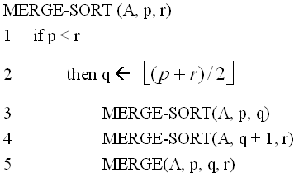
Merge-Sort (A, p, r)
INPUT: a sequence of n numbers stored in array A
OUTPUT: an ordered sequence of n numbers

Slide 33
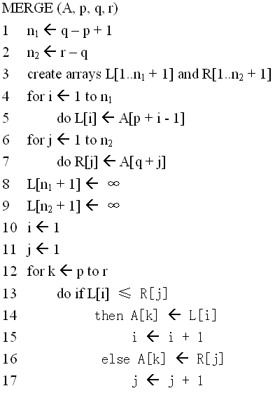
Merge (A, p, q, r)
R

Slide 34
Action of Merge
L/R
(1)
(2)
(3)
(4)
(1)
(2)
(3)
(4)
V
3
20
22
26
10
12
14
16
i=1
j=1
k=9
A
(9)
(10)
(11)
(12)
(13)
(14)
(15)
(16)
V
3
i=1 j=1 k=9

Slide 35
Action of Merge
L/R
(1)
(2)
(3)
(4)
(1)
(2)
(3)
(4)
V
3
20
22
26
10
12
14
16
i=2
j=1
k=10
A
(9)
(10)
(11)
(12)
(13)
(14)
(15)
(16)
V
3
10
i=2 j=1 k=10

Slide 36
Action of Merge
L/R
(1)
(2)
(3)
(4)
(1)
(2)
(3)
(4)
V
3
20
22
26
10
12
14
16
i=2
j=2
k=11
A
(9)
(10)
(11)
(12)
(13)
(14)
(15)
(16)
V
3
10
12
i=2 j=2 k=11

Slide 37
Action of Merge
L/R
(1)
(2)
(3)
(4)
(1)
(2)
(3)
(4)
V
3
20
22
26
10
12
14
16
i=2
j=3
k=12
A
(9)
(10)
(11)
(12)
(13)
(14)
(15)
(16)
V
3
10
12
14
i=2 j=3 k=12

Slide 38
Action of Merge
L/R
(1)
(2)
(3)
(4)
(1)
(2)
(3)
(4)
V
3
20
22
26
10
12
14
16
i=2
j=4
k=13
A
(9)
(10)
(11)
(12)
(13)
(14)
(15)
(16)
V
3
10
12
14
16
i=2 j=4 k=13

Slide 39
Action of Merge
L/R
(1)
(2)
(3)
(4)
(1)
(2)
(3)
(4)
V
3
20
22
26
10
12
14
16
∞
i=2
k=14
j=5
A
(9)
(10)
(11)
(12)
(13)
(14)
(15)
(16)
V
3
10
12
14
16
20
22
26
i=2 j=5 k=14

Slide 40
Action of Merge Sort
1 2 2 3 4 5 6 7
merge
2 4 5 7
1 2 3 6
merge
merge
2 5
4 7
1 3
2 6
merge
merge
merge
merge
5
2
4
7
1
3
2
6
Initial
Sequence

Slide 41
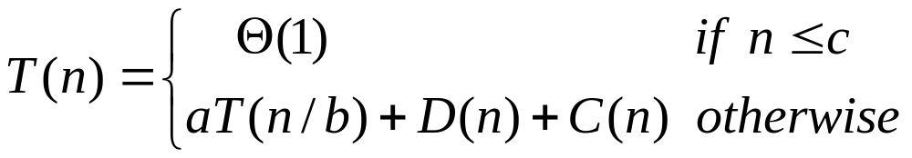
Analysis divide-and-conquer algorithms
Let T(n) be the running time on a problem of size n.
-- Suppose that our division of the problem yields a subproblems, each of which is 1/b the size of the original..
-- D(n): the time to divide the problem into subproblems.
-- C(n): the time to combine the solutions to subproblems into the solution to the original problem
Recurrence Equation
Θ-Notation

Slide 42
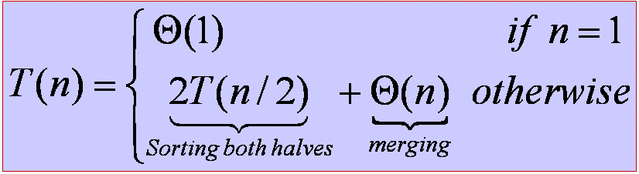
Mergesort Analysis
How long does mergesort take?
-- Bottleneck = merging (and copying).
>> merging two files of size n/2 requires n comparisons
-- T(n) = comparisons to mergesort n elements.
>>to make analysis cleaner, assume n is a power of 2
Claim. T(n) = n lg₂n
-- Note: same number of comparisons for ANY file.
>> even already sorted
-- We’ll prove in several different ways to illustrate standard techniques.

Slide 43
Proof by Picture of Recursion Tree
T(n)

Slide 44
Proof by Picture of Recursion Tree
c(n)
T(n/2)
T(n/2)

Slide 45
Proof by Picture of Recursion Tree
c(n)
cn/2
cn/2
T(n/4)
T(n/4)
T(n/4)
T(n/4)

Slide 46
Construction of Recursion Tree
c(n)
cn
cn/2
cn/2
2(cn/2)
cn/4
cn/4
cn/4
cn/4
4(cn/4)
lgn+1
cn/2^{k}
2^{k}(cn/2^{k})
c
c
c
c
c
c
c
c
cn
Total: cnlgn+cn
The full expanded tree has lgn+1 levels, i.e., it has height lgn, and each level contributes a total cost of cn. The total cost is Θ(nlgn)

Slide 47
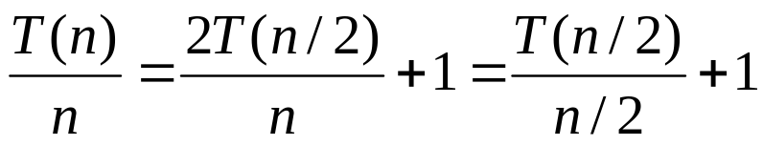
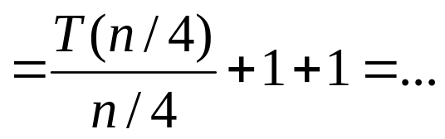
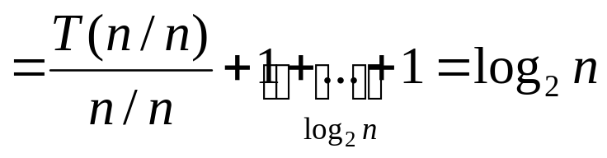
Proof by Telescoping
Claim. T(n)=nlog₂n (when n is a power of 2).
Proof. For n > 1:

Slide 48
Mathematical Induction
Mathematical induction.
  Powerful and general proof technique in discrete mathematics.
  To prove a theorem true for all integers k≥0:
    Base case: prove it to be true for n = 0;
    Induction hypothesis: assuming it is true for arbitrary n
    Induction step: show it is true for n+1
Claim: 0 + 1+ 2+3 + … + n = n(n + 1)/2 for all n≥0
Proof: (by mathematical induction)
  Base case (n=0)
    0 = 0(0+1)/2
  Induction hypothesis: assume 0 + 1 + 2 + … + n = n(n+1) / 2
  Induction step: 0 + 1 + 2 + … + n + n + 1 = n(n+1) / 2 + n + 1
  = (n+1)(n+2)/2

Slide 49
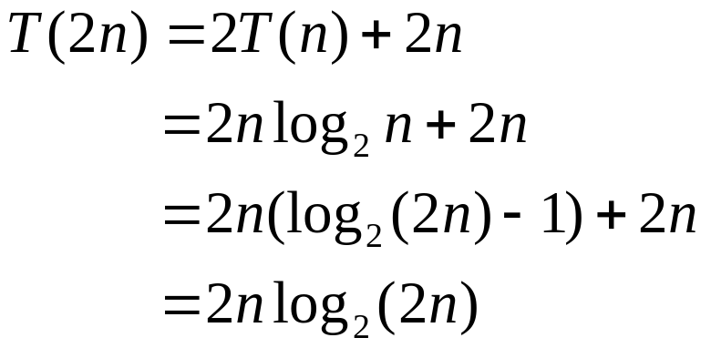
Proof by Induction
Claim. T(n)=nlog₂n (when n is a power of 2).
Proof. (by induction on n)
--Base case: n = 1.
--Inductive hypothesis: T(n) = nlog₂n.
--Goal: show that T(2n) = 2nlog₂(2n)

Slide 50
Computational Complexity
Framework to study efficiency of algorithms. Example=sorting.
--MACHINE MODEL = count fundamental operations.
>>count number of comparisons
--UPPER BOUND = algorithm to solve the problem (worst case.)
>>nlog₂n from mergesort
--LOWER BOUND=proof that not algorithm can do better
>>nlog₂n 、nlog₂e
--OPTIMAL ALGORITHM: lower bound ~ upper bound.
>>mergesort

Slide 51
Homework
2.1-1，2.1-3，2.2-1，2.3-1，2.3-7

Slide 52
Θ--notation
Math:
Θ(g(n)) = {f(n): There exist positive constants c₁, c₂, and n₀ > 0 such that 0≤c₁g(n) ≤f(n)≤c₂g(n) for all n≥n₀}
Engineering:
--Drop low-order terms; ignore leading constants.
--Example: 3n³ + 90n² – 5n + 6046 = Θ(n³)

Slide 53
Asymptotic performance
When n gets larger enough, a Θ(n²) algorithm always beats a Θ(n³) algorithm
-- We shouldn’t ignore asymptotically slower algorithms, however.
-- Real-world design situations often call for a careful balancing of engineering objectives.
-- Asymptotic analysis is a useful tool to help to structure our thinking.
back

